Slide 1
NEXTHIKES IT SOLUTIONS
PROJECT-
FEATURE EXTRACTION AND PRICE PREDICTION
FOR MOBILE PHONES
BY- SAKSHI JAISWAL

Slide 2
DATASET OVERVIEW
Total rows- 541
Total features-12
Target variable- Price
Contains both numerical and categorical features describing mobile specifications

Slide 3
DATA PREPROCESSING
Remove unnecessary columns
Fix column names- Prize: Price, Battery_: Battery, Processor_: Processor
Remove comma from price
Convert camera columns
Convert numeric columns properly
Remove outliers
Encode categorical values using label encoding

Slide 4
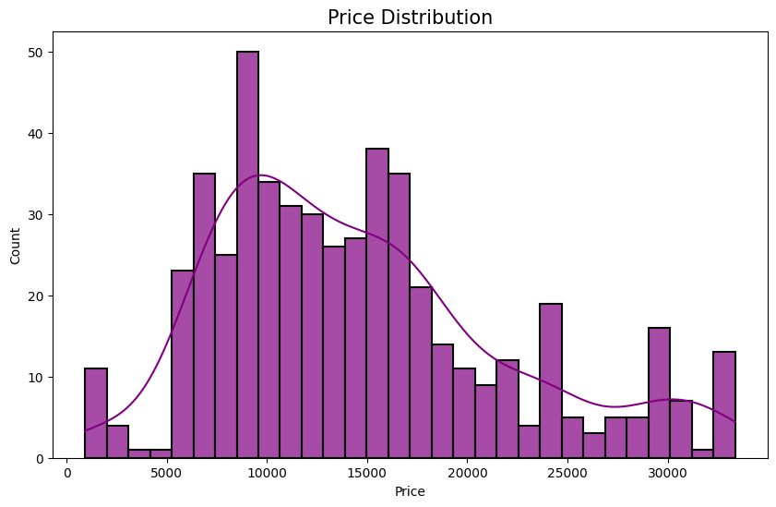
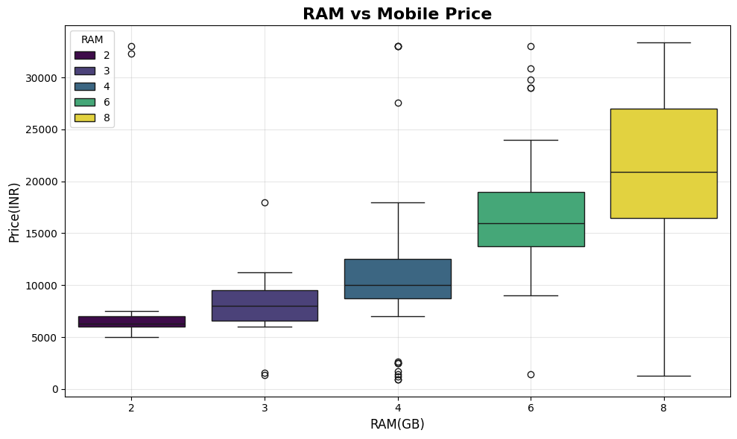
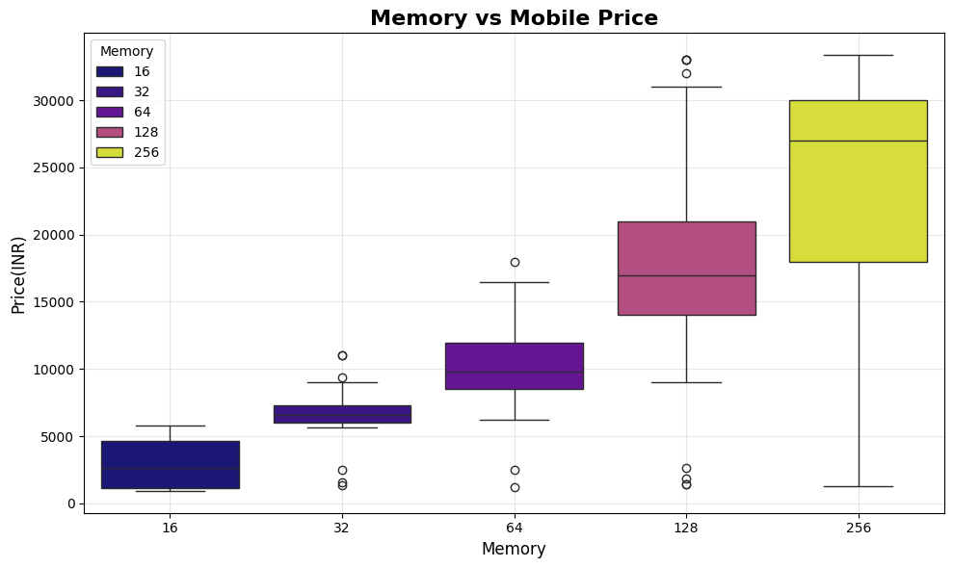
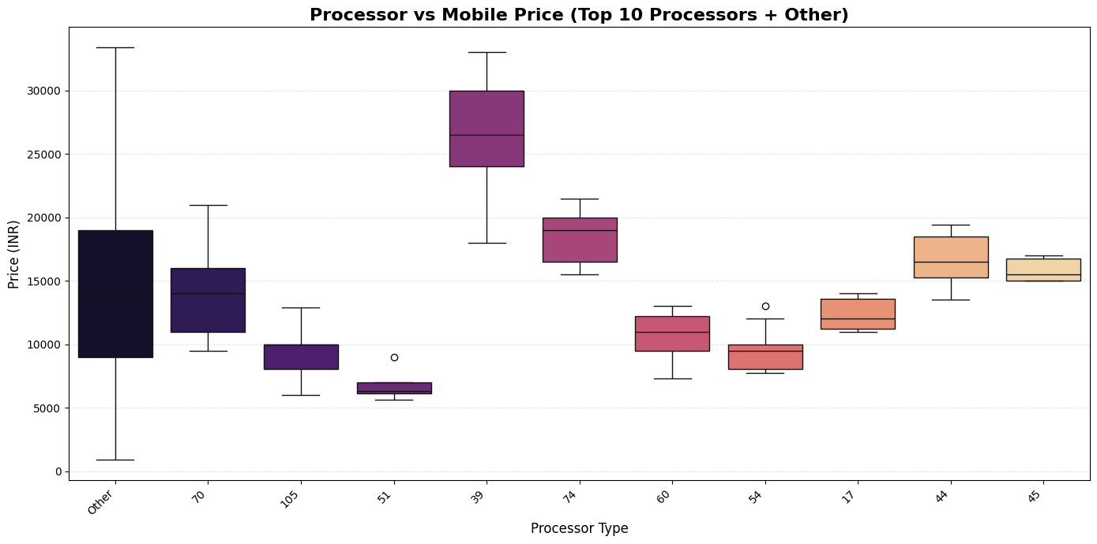
FEATURE EXTRACTION

Slide 5
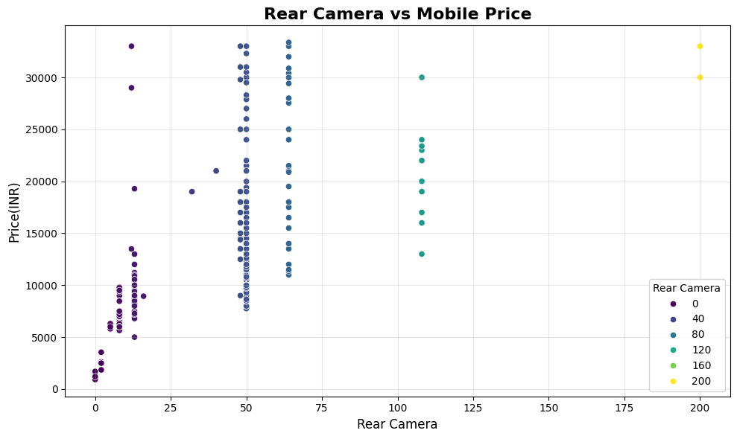
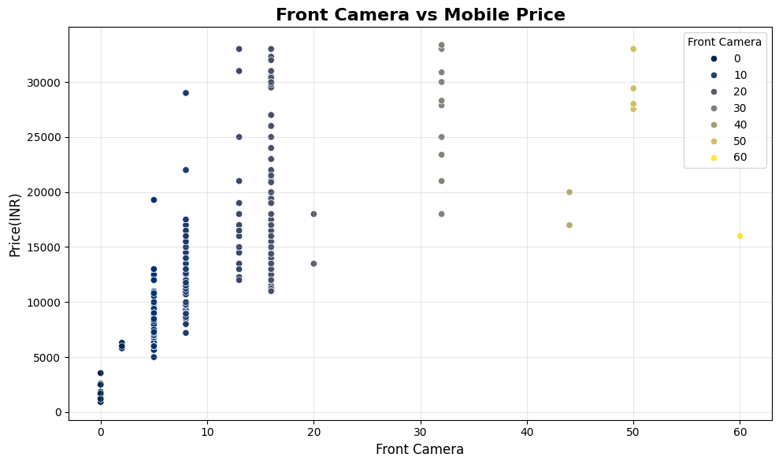
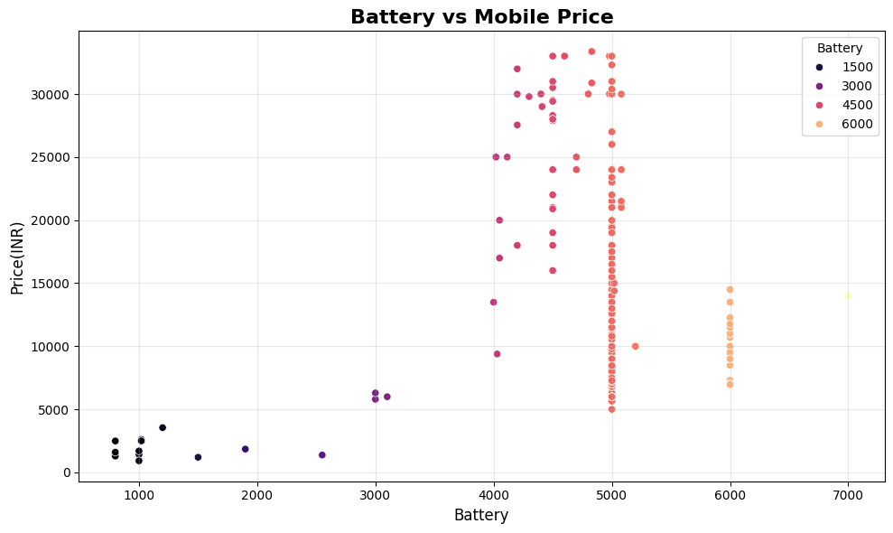
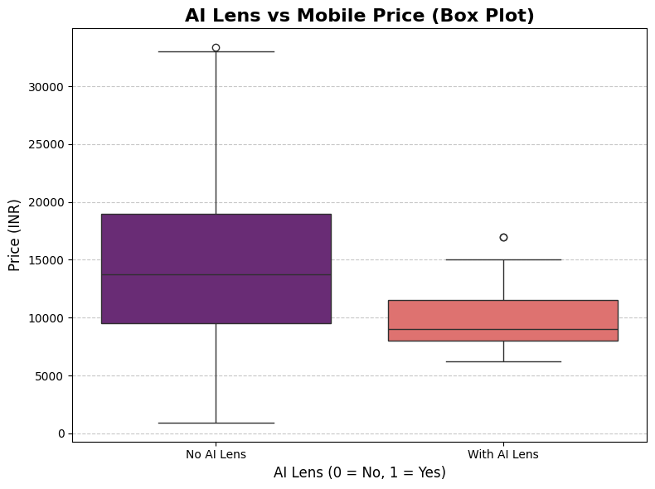

Slide 6
MODEL BUILDING
Feature & Target Split
Target variable : Price
Remove unnecessary columns and handled categorical variables
Train- Test Split
80% training data
20% Testing data
Random state= 42 (for reproducibility)
Model Selection
Random Forest – handles complex relationships
- reduces overfitting
- provides feature importance
- works well with mixed feature types

Slide 7
MODEL EVALUATION
MODEL PERFORMANCE ANALYSIS
Model explains 92.5% of price variation
Low MAE & RMSE indicates strong predictive accuracy
Random Forest significantly outperformed Linear Regression

Slide 8
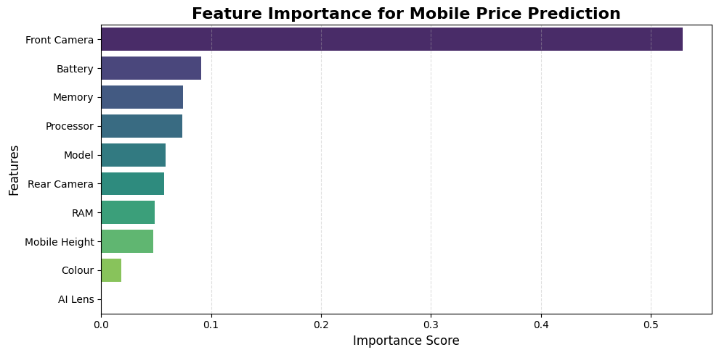
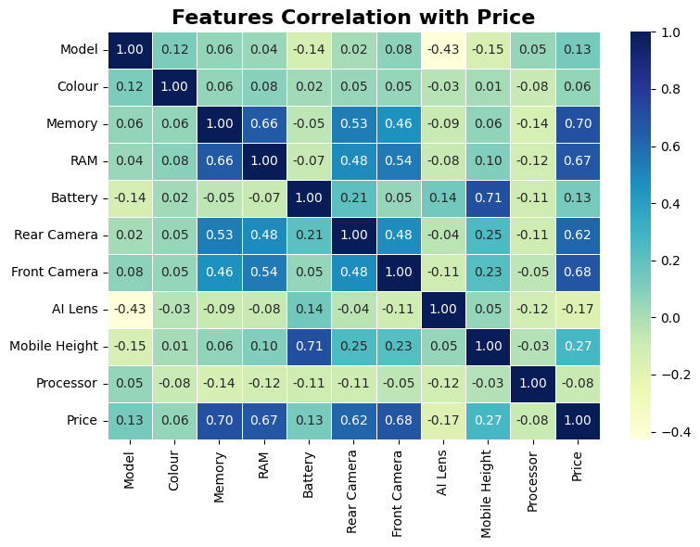
FEATURE IMPORTANCE
TOP FEATURES:
Front Camera stands out as by far the most important
feature, indicating that its specifications are a primary driver of mobile phone price.
Battery, Memory, and Processor follow as the next most significant factors, suggesting that better specifications in these areas notably increase a device's value.
Model, Rear Camera, RAM, and Mobile Height have a moderate level of importance, contributing to the price but to a lesser degree than the top features.
Colour and AI Lens show very low, almost negligible importance, implying that these attributes have minimal impact on the overall price prediction by the model.

Slide 9
Conclusion
Model explains 92% of price variation
Low MAE and RMSE indicate high accuracy
Key price influencing factors- front camera, battery, memory,processor model influenced the most

Slide 10
THANK YOU

